Slide 1

AaaS: ACL as a Service
Group 2
Peng Zhang (CTBRI)，Frank Zhou (FNII)，Wenyao Huang (SZU)
Jan.23th,2016

Slide 2

Contens
点击添加文本
Why AaaS
Our solution
点击添加文本
Detail of our solutions
summary
点击添加文本
点击添加文本

Slide 3
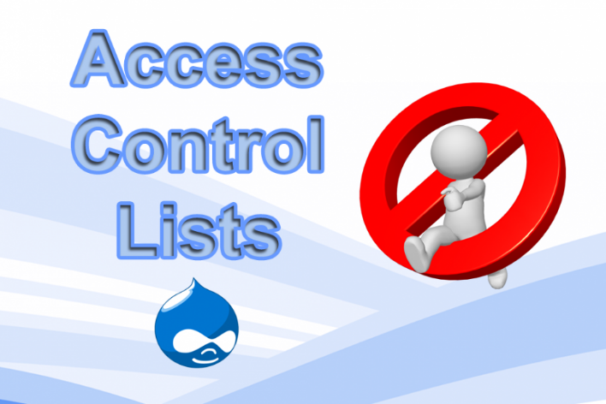
Why AaaS
ACL is useful
Provide a basic level of security for the network
Offer flow control for network traffic
But...
Configuration is painful
Lots of network devices
Error-prone
Our opinion
Provide ACL as a Service
Offer Restful API
One API, everyting set
Our potential customers:
Network operator
Internet Company
ODL Bootcamp

Slide 4
Our solution(Tech)
Design of architecture
app layer
Web UI
DEMO
点击添加文本
API
API
点击添加文本
AaaS Service
abs layer
YANG model
点击添加文本
MD-SAL
NETCONF
BGP-LS
点击添加文本
phy layer
Physical network

Slide 5
Our Work flow
GUI
Demo
Get BGP-LS Topo
Set ACL
BGP Plugin
AaaS Service
BGP Peer
Set datastore with java
routers
Netconf Plugin
routers
routers
routers

Slide 6
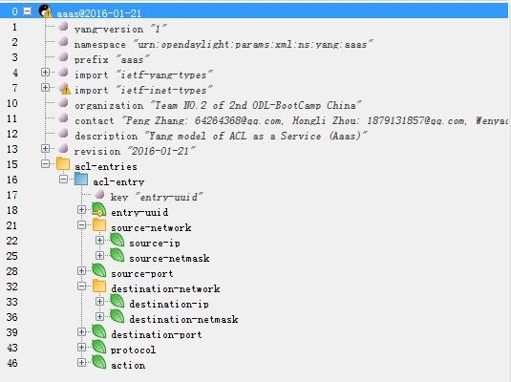
Detail of solution
Our defined YANG
点击添加文本
点击添加文本
点击添加文本
点击添加文本

Slide 7
Detail of solution
REST API Design
Operation | How to invoke
Query | GET http://odl:8181/restconf/config/aaas:acl-entries/acl-entry/bar
Delete | DELETE http://odl:8181/restconf/config/aaas:acl-entries/acl-entry/bar
Modify | PUT http://odl:8181/restconf/config/aaas:acl-entries/acl-entry/bar
Create | POST http://odl:8181/restconf/config/aaas:acl-entries
点击添加文本
Operation | How to invoke
Query
Delete
Modify
Add
点击添加文本
点击添加文本
点击添加文本
For more detail,go to attachment

Slide 8
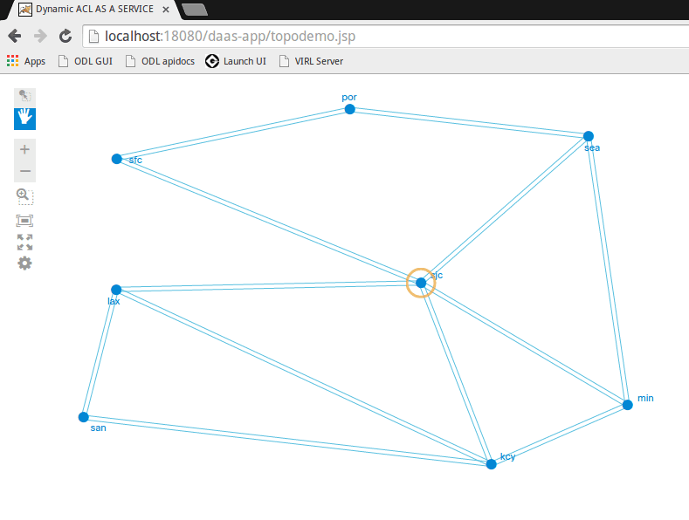
Detail of solution
Web UI Design(Get topology Dynamically)
点击添加文本
点击添加文本
点击添加文本
点击添加文本

Slide 9
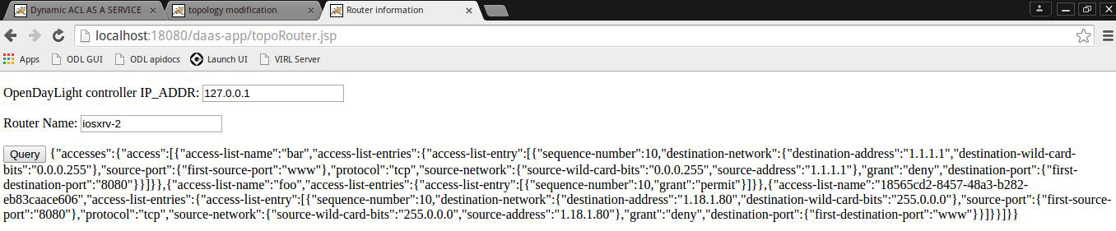
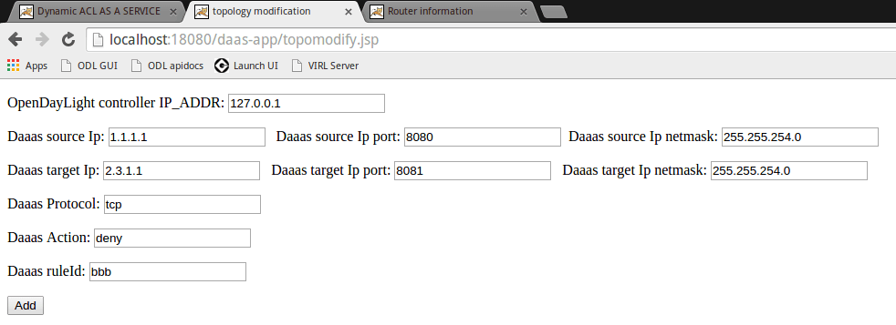
Detail of solution
Web UI Design(Query & Create)
点击添加文本
点击添加文本
点击添加文本
点击添加文本

Slide 10
Our solution
What tech in ODL we use
External app:
1 | Web: JSP /Servlet
2 | Restconf: Apache HttpClient
3 | Topo UI: cisco NeXt framework
4 | Json parse: jackson
点击添加文本
点击添加文本
Internal app:
1 | YANG model
2 | Maven
3 | MD-SAL
点击添加文本
点击添加文本

Slide 11
Summary
we embody an internal app based on ODL, which tries to facilitate the configuration and management of ACL,with what we learned in the ODL bootcamp.Also We Use Cisco's cisco next ui framwork to operate the network and show our works.
点击添加文本
点击添加文本
For the internal app, it realizes ACL configuration on all the router we needed and provide APIs for advanced users. Besides, we use Cisco Next UI to show how to configure the ACL
点击添加文本
We provide 1 api docs and 1 introduction slide.
点击添加文本

Slide 12
Behind of solution
Our original ideas:
Limit traffic flood to specific destination. For example, on the Alibaba’s shopping day of 11th Nov, a flood of traffic would break down servers and waste precious bandwidth.
To solve this, our first idea is using randomly drop some packets or limit rate. We think these mothods can low down the server's load and Clients will still have a chance to connect to server and get service.
Problems:
Firstly, QoS yang and Flow Spec are not supported by XRV right now. Secoundly, It is hard to generate packerts flood in dcloud.
Decision :
ACL yang is support but not fit to our idea. So why not open ACL setting as a Service?
点击添加文本
点击添加文本
点击添加文本
点击添加文本

Slide 13



Future work
AaaS is just the beginning. We will continue to open our network, let our customers can use network to solve their problems more efficiently.
QaaS: QoS as a Service
RaaS: Route as a Service
EaaS: Everything as a Service
点击添加文本
点击添加文本
点击添加文本
Our customer server
Advanced ACL
点击添加文本
QOS
Customers' main clients region

Slide 14
Q&A
点击添加文本
Thank you
点击添加文本
点击添加文本
点击添加文本

